Slide 1
Single Image Blind Deblurring Using MAP Estimation
Group No.2
Goutam Chourashia-24V0038
Vaibhav Bhatnagar-23M1062
Sai Chandu Pusoju-24M1066

Slide 2
Introduction to Blind Deblurring
Definition: Blind deblurring addresses the challenge of removing motion blur from images when both the blur kernel and the sharp image are unknown.
Importance: Essential for enhancing image clarity in various applications such as surveillance, photography, and autonomous systems.

Slide 3
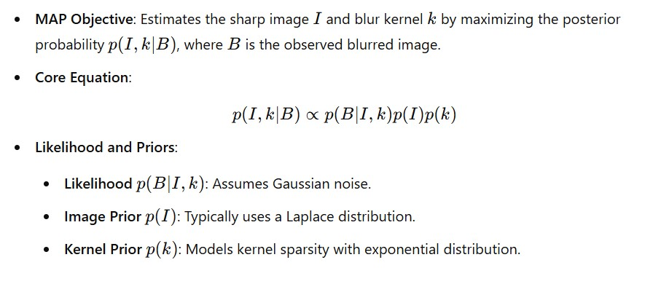
MAP Framework in Deblurring

Slide 4
MAP Optimization Process
Energy Minimization: The MAP problem transforms into an energy minimization task:
Iterative Process:
Alternating steps to estimate I (sharp image) and K (blur kernel).
Challenges with this approach include noise and artifact sensitivity in initial stages.

Slide 5
Latent Image Estimation
In each iteration, given the current kernel estimate, we solve for the latent image I by minimizing:
Icar, thr: Represents the cartoon component of the image after thresholding gradients. This step allows the algorithm to focus on strong edges by ignoring smaller gradients.
Objective: Enhance the clarity of the latent image while preserving significant image structures.

Slide 6

Kernel Estimation
The kernel k is updated by minimizing:
Sparsity Prior: The L1 regularization term Lambda 2 encourages sparsity in the kernel to represent camera motion effectively.
Purpose: Suppress noise and irrelevant values to ensure an accurate representation of the motion blur kernel.

Slide 7
Enhanced MAP with Image Decomposition
Image Decomposition: Separates the image into cartoon (smooth regions) and texture components.
Benefits of Decomposition:
Stability: Helps reduce artifacts in early iterations.
Kernel Estimation: Improves kernel accuracy by focusing on essential edges rather than textures.

Slide 8
Algorithm Overview
Initial Kernel and Image Estimation
Decomposition: Retain the cartoon component for stability.
Kernel Update: Re-estimate the kernel using the cartoon component.
Repeat until convergence.

Slide 9
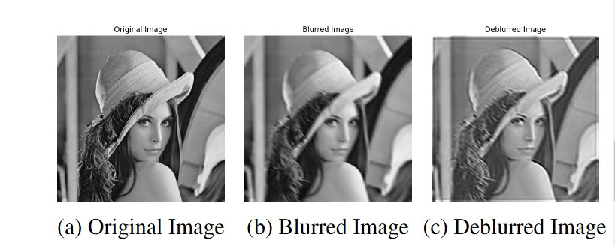
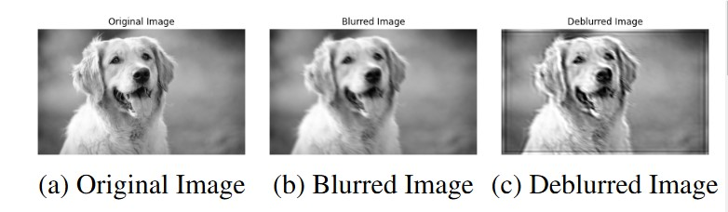
Results
Comparison of the original, blurred, and deblurred images using the proposed method

Slide 10
Pros and Cons of MAP Technique
Pros:
Integrates image priors and kernel constraints effectively.
Adaptive to different blur types and intensities.
Robust when enhanced with decomposition.
Cons:
Computationally intensive due to iterative optimization.
Sensitive to noise without decomposition.
Can be less effective for very complex motion blurs.

Slide 11
Conclusion and Future Prospects
Conclusion:
MAP-based deblurring, enhanced with image decomposition, provides a robust solution for blind deblurring in single images.
Shows significant improvement in preserving detail and reducing artifacts.
Future Prospects:
Exploration of advanced priors and constraints.
Integration with deep learning models for improved adaptability.
Real-time applications through optimization of the MAP framework.

Slide 12
References
Xu, Y., Hu, X., Wang, L., & Peng, S. "Single Image Blind Deblurring with Image Decomposition." Proceedings of IEEE International Conference on Acoustics, Speech and Signal Processing (ICASSP), 2012, pp. 929-932.
Cho, S., & Lee, S. "Fast Motion Deblurring." ACM Transactions on Graphics, vol. 28, 2009
Levin, A., Weiss, Y., Durand, F., & Freeman, W. T. "Understanding and Evaluating Blind Deconvolution Algorithms." IEEE Conference on Computer Vision and Pattern Recognition (CVPR), 2009.

Slide 13


